Slide 1
Philosophy as a form of science

Slide 2
Theorys of philosophy’s appearance:
1) mythological – according to this theory philosophy is based on the different myths (elementary form of the worlds perception);
2) gnoseological - according to this theory philosophy was created as a first form of science specially for the exploration of the world;
3) cultural - according to this theory appearance of philosophy was a result of a high level development of the culture of ancient Greece.

Slide 3
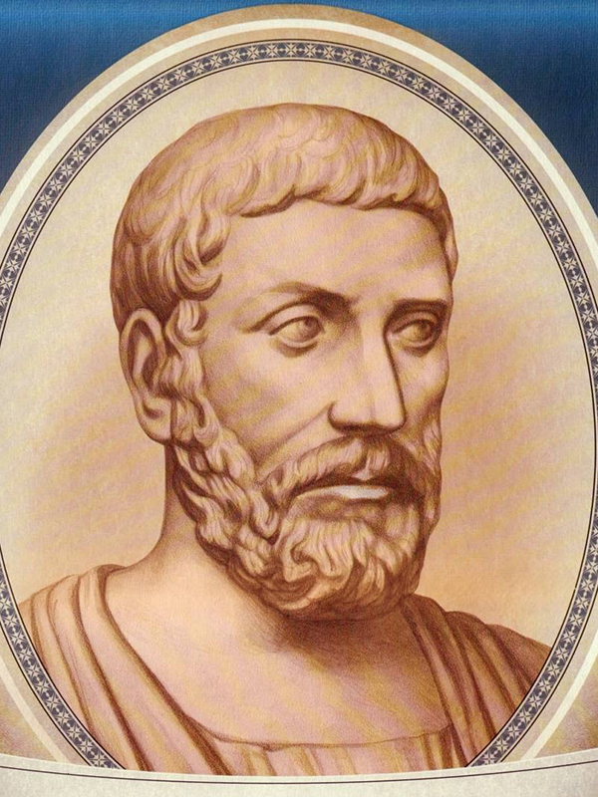
Philosophy ( from ancient greek – love to wisdom)
-this is a special form of worlds perception, that formes most important representations about development of nature, society and existence of human
The author of term was
mathematician and philosopher
Pythagoras(570-495)

Slide 4
Оbject and subject of philosophy
Оbject of study of philosophy: a man and world around him;
Subject of study of philosophy: he essence of the processes, phenomena and laws that determine the existence of the world and man

Slide 5
Interaction between philosophy and medicine
Philosophy | Medicine
Anthropocentrism - type of world perception that recognizes the human as basic element of the world’s development
Plurality- the type of philosophical worldview that recognizes necessity for several points of view about the same issue;
Humanism- the type of philosophical worldview that recognizes absolute value of human life.

Slide 6
Main functions of philosophy:
1) worldview- it help us to get a special look at the surrounding world;
2) methodological - is responsible for the development of methods of understanding the world;
3) critical - forms the basis of the critical thinking about different processes of the world;
4) predictive - it forms possibility to predict the possible options for the development of the society,nature and state

Slide 7
Sections of philosophy
Section name | Subject of study
The ontology | the existence
The gnoseology | the forms of the world’s perception
The axiology | the values of human and society
The logic | the laws of thinking
The dialectics | the contradictions of human life and of the world’s development
The ethics | the norms and rules of human behavior in society;
The esthetics | different types of beauty

Slide 8
The basic question of philosophy is: what is primary - existence or mind?
existence govern our mind
mind govern
our existence

Slide 9
The Idealism – type of philosophy according to which possibilities of world’s understanding are limited because we cant explain some events by our mind;
Platon (427-347 b.c.)
Pythagoras (570-495 b.c)

Slide 10
Platon about existence
Pythagoras about existence
Existence is a world of ideas; the most important among them is idea of goodness.
Existence is a world of ideas and numbers; the most important among them is idea of harmony.

Slide 11
The materialism– type of philosophy according to which our possibilities of world’s understanding has no limits because its material; The materialism was founded by ancient Greek philosopher Democrit

Slide 12
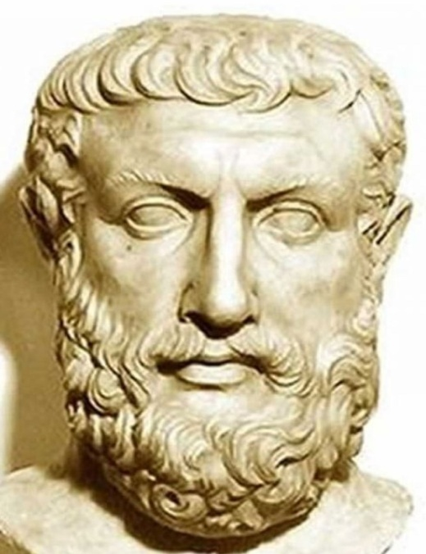
The main idea philosophy is existence
Existence – is the category, which designating
different aspects of human being and development of the world.
The author of this concept
was a greek philosopher
Parmenides.

Slide 13
Concept of non-existence by Heraclit
Heraclit (585-483 b.c.)
non-existence
this is the category, which designating not only the death of human but also his transition to the other quality.

Slide 14
Тhe main historical epochs of the development of philosophy

Slide 15
Middle Ages (5-15 centuries / 400-1400 years.)
During this period philosophy occupies a subordinate position to theology.
Sphere of philosophical research: Questions of faith, religion, proof of the existence of God.
Main directions:
Patristics – type of philosophy, which is based on the doctrines of Catholic church (created by St. Augustine)
Sholastics - type of philosophy, which is based on the proofs of God’s existence(created by Thomas Aquinas)

Slide 16
Aurelius Augustin (354-430years) - philosopher, patristics, author of the book “The city of God”

Slide 17
Thomas the Aquinas (1225-1274 years) philosopherof scholasticism,author of the book “The sum of theology”

Slide 18
Рhilosophy of the Renaissance (14-16 centuries / 1300-1500 years)

Slide 19
Renaissance(14-16 centuries / 1300-1500 years)
The philosophy of this period was characterized by:
1) secularization- the process of separation of church and state;
2) Philosophy becames independent from theology;
3) science returns to the ancient tradition of anthropocentrism.
The main philosophers of this period were:

Slide 20
Michel de Montaigne(1533-1592) french philosopher, author of the book “The expirienses”

Slide 21
Тhомаs Mоr (1478 – 1535) british philosopher , author of the book “The Utopy”

Slide 22
Niccolo Makiavelli (1469-1527) – italian philosopher, author of the book «The Monarch»

Slide 23
Рhilosophy of the New Age
(17-18 centuries / 1600-1700)

Slide 24
The main object of the study of philosophy was problem of knowledge.
The main directions of the New Ages philosophy:
1) rationalism - type of philosophy, which recognize mind as a only one way of world cognition(created by Rene Descartes (1632-1704;)
2) empiricism – type of philosophy, which recognize experience as a only one way of the world cognition (created by Francis Bacon (1561-1626);
3) sensualism- type of philosophy, which recognize sence as a only one way of the world cognition (created by John Locke (1632-1704).
The main philosophers of this period were:

Slide 25
Rene Decartes (1632-1704) french philosopher of rationalism, author of the book “The issue about the method”

Slide 26
Francis Bacon(1561-1626) british philosopher of the empiricism, author of the book “The New Organon”

Slide 27
John Locke (1632-1704) british philosopher sensualism, author of the book “The issue about the goverment”

Slide 28
Type of philosophy | Form of world cognition
rationalism | mind
empiricism | Life experience
sensualism | sence

Slide 29
Рhilosophy of the Еnlightenment
(17-18 centuries / 1600-1700)

Slide 30
The aim of philosophy- become an applied science that can give a person the necessary minimum of knowledge about the world and the development of society;
The main directions:
1)deism - type of philosophy, according to which God creates world but don’t control it;
2)geographical determinism – type of phylosophy, defining geography as a main factor of political, economical and cultural development of the state
The main philosophers of this period was:

Slide 31
Francois Voltaire (1694-1778) - french philosopher of deism, author of the book “Philosophy of history”

Slide 32
Jean-Jacques Rousseau (1712-1778) french philosopher of deism, author of the book “The issue about the eternal world”

Slide 33
Charles de Montesquieu (1712-1778) french philosopher of geographical determinism, author of the book “The power of climate”

Slide 34
Deni Diderot (1736-1784) french philosopher deism, author of the book “Encyclopedia”

Slide 35
The german classical philosophy
(18-19 centuries / 1700-1800)

Slide 36
Almost all philosophers of this period were idealistic;
The object of research:
- development of the world and of man, society and the state;
- the problem of knowledge and its limits;
- the laws of history.
Main areas: subjective idealism, objective idealism, materialism.
The main representatives of this period was:

Slide 37
Emmanuel Kant (1724-1804) – german philosopher of idealism, author of the book “The critique of a perfect mind”

Slide 38
Georg Gegel (1770-1831) german philosopher of idealism, author of the book “Philosophy of law”, author of the laws of dialectic

Slide 39
Johann Fichte (1762-1841) german philosopher of idealism, author of the book “Separated trading state”

Slide 40
Friedrich Schelling (1775-1854) german philosopher of idealism, author of the book “Philosophy of nature”

Slide 41
Ludwig Feerbach (1804-1872) german philosopher of antropological materialism, author of the book “The essence of christianity”

Slide 42
Summary:
1) philosophy is the special form of world’s perception;
2) philosophy is the first form of science;
3) object of research of philosophy: the world around us;
4) subject of research subject of research : the most common patterns of development of the world and man in it.

